Slide 1
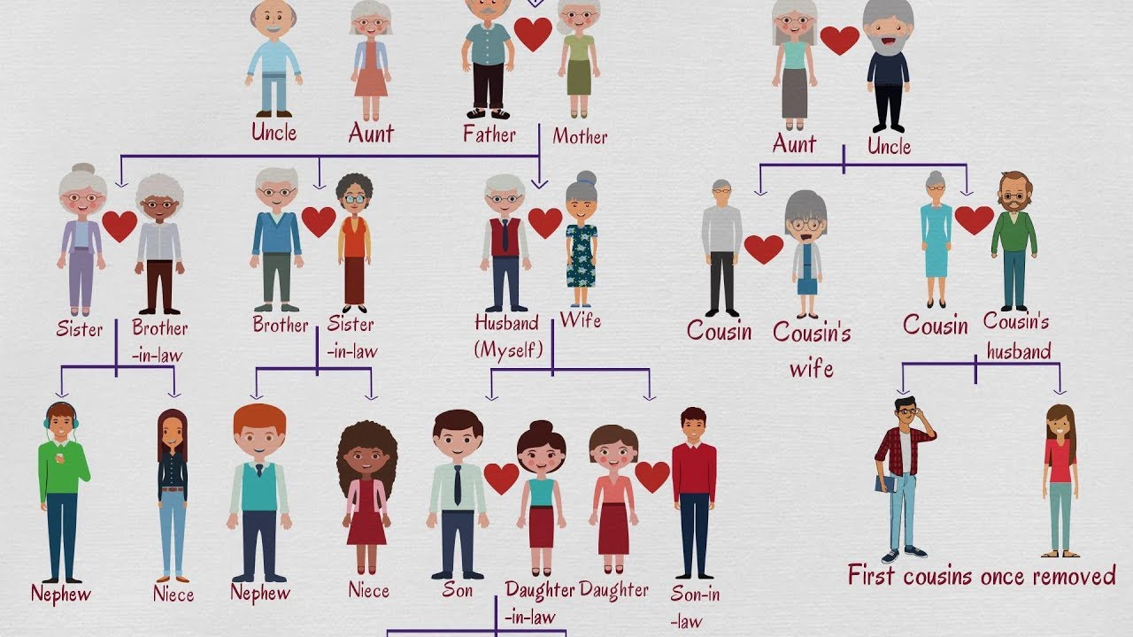

BLOOD RELATIONS
SHABANA
ALLPPT.com _ Free PowerPoint Templates, Diagrams and Charts

Slide 2

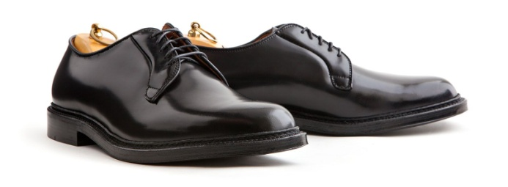

MONEY
Mayor Brogan was a man of great honesty. The other day he went to his
favourite Haberdashery store and said to the man in the hat department, “I
want that $10.00 hat in the window. If you lend me as much as I have in my
pocket I’ll buy it”. The sales man said ok and gave him the
money. The mayor then paid cash for the
hat. Next he went to the suit department
and bought a $10.00 jacket
using the same proposition. On the way out he stopped in the
Shoe department and bought a $10.00 pair of shoes, paying
in the same way. When he left the store, he had no money
in his pockets. How much money did Brogan have when he first entered the
store?

Slide 3
NEPHEW
UNCLE
SIBLINGS
COUSINS
MOTHER
IN LAWS
GRAND FATHER
FATHER
GRAND MOTHER
MATERNAL / PATERNAL
AUNT
COUPLES
NIECE

Slide 4
KICK START

Slide 5
QUESTION - TYPES
POINTING A PICTURE / PERSON
PARAGRAPHS – SMALL DATA’s
PARAGRAPHS – LARGE DATA’s
DEFINED OPERATORS
DIFFERENT SETS OF VERTICALS OF DATA

Slide 6
POINTING A PICTURE / PERSON
Pointing towards a person in a photograph, Aruna said “He is the only son of the father of my
sister’s brother” How is that person related to Aruna?
A Maternal uncle B Son C Father
D Brother
Pointing to a photograph, a woman says, ”This man’s son’s sister is my mother-in-law” .How is the
woman’s husband related to a man in the photograph?
A Son-in-law B Son C Grandson
D Nephew
A woman while looking at the photograph of a man said “He is the maternal grandfather of children of my husband’s sister. How is the man related to the woman?
A Father B Father-in-law
C Grandfather D Brother-in-law

Slide 7
POINTING A PICTURE / PERSON
Looking at a picture of a boy, Hemant said, “His mother is the wife of my father’s son. Brothers and sisters I have none.” At whose picture was Hemant looking?
A His son B His cousin C His uncle
D His nephew E None of these
Amit said “This girl is the wife of the grandson of my mother”. How is Amit related to that girl?
A Brother B Grandfather C Husband
D Father-in-law
Pointing to a boy a woman says, “His father is father-in-law of that person whose father is father-in-law of mine.” Then how boy is related to the woman?
A Son B Brother C Son-in-law D Brother-in-law

Slide 8

PARAGRAPHS – SMALL DATA’s
A family consists of six members P,Q,R,X,Y and Z. Q is the son of R but R is not mother of Q. P and R are a married couple. Y is the brother of R. X is the daughter of P. Z is the brother of P. How is Q
related to X.
A Husband b) Father c) Brother d) Uncle
Shoba is the niece of Ashish. Ashish’s mother is Priya. Kamala is Priya’s mother. kamala’s husband is
Hari. Krish is the mother-in-law of Hari. How is Shoba related to Hari?
A Daughter B Great granddaughter C Grand niece
D Great grandson daughter

Slide 9
PARAGRAPHS – SMALL DATA’s
In a family there are 6 members A,B,C,D,E and F. A and B are a married couple. A being the male
member. D is the only son of C, who is the brother of A. E is the sister of D. B is the daughter in law of
F. whose husband has died. How is F related to A?
A Mother B Sister-in-law C Sister
D Mother-in-law E None
Ashok is son of Ashwin’s father’s sister. Akash is son of Thaaru, who is mother of Vijay and grand
mother of Ashwin. Hari is father of Nila and grandfather of Ashok. Thaaru is wife of Hari.
How is Vijay’s wife related to Nila?
A Sister B Niece C Sister-in-law
D Data Inadequate E None of these

Slide 10
QUICK REVISION
D is the brother of B, M is the brother of B, K is the father of M and T is the wife of K. How is B related to T?
a)Son b) Daughter c) Father d) Cannot be determined
A and B are married couple. X and Y are brothers. X is the brother of A .How is Y related to B?
a) Brother –in-law b) Brother c) Cousin d) None
B is the husband of P. Q is the only Grandson of E, who is wife of D and Mother –in-law of P. How is B
related to D?
a)Nephew b)cousin c)son-in-law d)son

Slide 11
QUICK REVISION
B is the sister of D, M is the father of D, N is the sister of M. How is N related to B?
a)Daughter b) Mother c) Niece d) None
A is the father of X, B is the mother of Y. The sister of X and Z is Y. Which of the following statement is definitely not true?
a)B is the mother of Z b) X is the sister of Z
c) Y is the son of A d) B has one daughter
Pointing towards a person, a man said to a woman, “His mother is the only daughter of your father”.
How is the woman related to that person?
a)Daughter b) Sister
c) Mother d) Aunt

Slide 12

QUICK REVISION
Pointing to a photograph, a woman says, “This man’s son’s sister is my mother-in-law”. How is the
woman’s husband related to the man in the photograph?
a)Grandson b) Son c) Son-in-law d) Nephew
If Meena, a female, says, “Rani’s father, Ram, is the only son of my father-in-law Mohan”, then how is
Teena, who is the sister of Rani related to Mohan?
a)Niece b) Daughter c) Wife d) Grand-daughter

Slide 13
QUICK REVISION
Showing the man receiving the prize, Sunny said, “He is the brother of my uncle’s daughter”. How is
the man related to Sunny?
a)Son b) Nephew c) Uncle d) Cousin
Introducing a man, a woman said, “His wife is the only daughter of my father”. How is that man
related to that woman?
a)Brother b) Husband c) Maternal Uncle d) Father-in-law

Slide 14
PARAGRAPHS – LARGE DATA’s
In a family of seven, three generations are living together. The family consists of two married couples
having two children each. Kannan is Jyothika’s elder brother. Gopal is lucky to have two grandchildren.
There are two housewives in the family. Gopal, who is manoj’s father, is a lawyer and earn’s most.
Jyotsna is the sister of a lecturer and herself is a nurse. Anuradha is married to a lecturer who is
Nidhi’s son. Jyothika is the grand daughter of one of the housewives and is a classical dancer.
What is manoj’s profession?
How many male members are there in a family
Who are the children of Nidhi?

Slide 15
PARAGRAPHS – LARGE DATA’s
4. Which of the following statements is not true?
a) The Nurse is sister in law of the housewives. b) Gopal has two grand children.
c) Nidhi has a son and a daughter. d) Gopal has two children.
e) Anuradha has a son and a daughter.
5. Who among the following is one of the married couples
a) Gopal Jyotika b) Nidhi Gopal
c) Manoj Jyothika d) Can’t be determined
e) None of the above

Slide 16
PARAGRAPHS – LARGE DATA’s
Nine persons – L, M, N, O, P, Q, R, S AND T are the members in a family. M, N, R and S belongs to the same generation out of which M and S are siblings. L says that P is my sister Q’s grandmother’s only son’s only child. None of
them is a widow or widower. Q, S and N belongs to the same gender and the number of males is more than that of the females.
How is P related to Q?
a) Brother b) Sister c) Cousin d) Either (b) or (c)
How is N related to S?
a) Sister b) Sister-in-law c) Aunt d) Mother-in-law
How is P related to S?
a) Nephew b) Cousin c) Son d) Daughter
How is O related to L?
a) Father b) Grandmother c) Grandfather d)Cannot be determined

Slide 17
Directions: In a combined family Maahesh and Sudarsh are brothers. Both have one – one son and daughter each. Further information of their family is given below: Amar is brother-in-law of Mithun and husband of Amal’s mother. Mithun is unmarried son of Maahesh. Vaishnavi’s father, Vikram is son of Saanvi who is mother-in-law of Sadhana. Mainak’s grandmother, Kalini is mother-in-law of Amar. Madhuri and Mithun are children of Maahesh and Vikram and Tanvi are their cousins. Sadhana has two daughters and Madhuri have two sons. Juhi and Vaishnavi are siblings.
PARAGRAPHS – LARGE DATA’s
.

Slide 18
How does Vaishanvi relate to Sudarsh? A Daughter-in-law B Niece C Wife
D Granddaughter E None of these
Who among the following is the father of Varuna?
A Vikram B Amal C Amar
D M E None of these
How is Mainak related to Saanvi?
A Son of brother in law B Cousin of sister in law
C Grandson's cousin D Grandson of brother in law
E None of these

Slide 19
DEFINED OPERATORS
A+B means A is the son of B.
A-B means A is the wife of B.
A*B means A is the Brother of B.
A/B means A is the mother of B.
A=B means A is the sister of B.
What does P+R-Q mean?
a) Q is father of P b) Q is son of P
c) P is mother of Q d) Q is the sister of P
What does P*R/Q mean?
a) P is the wife of Q b) P is the uncle of Q
c) Q is the daughter of P d) Q is the mother of P.

Slide 20
DEFINED OPERATORS
(X*Y) means X is the brother of Y
(X+Y) means X is the daughter of Y.
(X-Y) means X is the husband of Y.
If(A+B-C),then
a) C is the mother of A b) C is sister in law of A c) C is aunt of A
d) C is mother in law of A e) None
If(A*B+C),then
A is the brother of C b) A is the uncle of C c) A is son of C
d) A is father of C e) None
If (A+B*C), then
A is the niece of C b) A is the daughter of C c) None
A is the cousin of C e) A is the daughter-in law of C

Slide 21
DEFINED OPERATORS
A+B means A is the daughter of B
A×B means A is the son of B
A-B means A is the wife of B
If P×Q-S which is true
S is wife of Q b) S is father of P c) P is daughter of C
d) Q is the father of P e) None
If T-S×B-M which of the following is not true?
B is the mother of S b) M is husband of B c) T is wife of S
d) S is daughter of B e) S is son of B
If Z×T-S×U+P, what is U to Z
Mother b) Grandmother c) Father
d) Can’t determined e) None

Slide 22
DEFINED OPERATORS
In a certain coded language:
‘X + Y’ means ‘Y is the brother of X’.
‘X ? Y’ means ‘X is the daughter of Y’.
‘X ! Y’ means ‘Y is the sister of X’.
‘X / Y’ means ‘X is the son of Y’.
‘X$Y’ means ‘X is the father of Y’.
‘X & Y’ means ‘X is the mother of Y’.
Which of the following can be derived from the given expression – “B$A!R?E&Y+D”?
A A?B B Y!R C A/E D D+R E All of these
How is J related to M in the following expression – “M/T$W?Q!J”?
A Niece B Paternal Aunt C Maternal Aunt D Mother E CBD
How is M related to V in the expression – “V/F!D+H$O?M”?
A Paternal Aunt B Maternal Aunt C Nephew D Niece E CBD

Slide 23
CONVERSATION
Some persons related to each other were going in a bus. When asked about their relationships,
following were their replies:
M says ‘N is my daughter in law and R is my father in law’. C says ‘T is my aunt and Z is my father’. Z says ‘S is my maternal grandmother and T is not my sister’. N says ‘Q is my father in law and L is my brother in law’. L says ‘P is my grandfather and C is my niece’.
How is N related to R?
A Granddaughter in law B Father in law C Sister in law
D Granddaughter E Grandson

Slide 24
CONVERSATION
Some persons related to each other were going in a bus. When asked about their relationships, following were their replies:
M says ‘N is my daughter in law and R is my father in law’. C says ‘T is my aunt and Z is my father’. Z says ‘S is my maternal grandmother and T is not my sister’. N says ‘Q is my father in law and L is my brother in law’. L says ‘P is my grandfather and C is my niece’.
How is the sister in law of L related to T?
A Daughter B Mother C Sister in law
D Aunt E Sister

Slide 25
CONVERSATION
Some persons related to each other were going in a bus. When asked about their relationships, following were their replies:
M says ‘N is my daughter in law and R is my father in law’. C says ‘T is my aunt and Z is my father’. Z says ‘S is my maternal grandmother and T is not my sister’. N says ‘Q is my father in law and L is my brother in law’. L says ‘P is my grandfather and C is my niece’.
How is C related to M?
A Daughter B Sister C Son D Granddaughter E Brother

Slide 26
CONVERSATION
Some persons related to each other were going in a bus. When asked about their relationships, following were their replies:
M says ‘N is my daughter in law and R is my father in law’. C says ‘T is my aunt and Z is my father’. Z says ‘S is my maternal grandmother and T is not my sister’. N says ‘Q is my father in law and L is my brother in law’. L says ‘P is my grandfather and C is my niece’.
How many female members are there in the family?
A 3 B 4 C 5 D 6 E Either 5 or 6

Slide 27
Directions: Study the following set of questions carefully and answer the questions given below. When Vinavi Patni, tops in her MBBS course, she becomes the 7th member of her family to join the profession. All other family members namely Tanuj, Neha, Mohit, Sahit, Reena and Vedita are working at Sawai Man Singh Hospital as doctors and Vinavi who is the youngest of the third generation, is all set to join them. In this family of three generations, there are two pairs of couples and two pairs of brothers and sisters. There are three Oncologists, two Dentists, one Physician and one Neurologist in the family. No female in the family is an Oncologist. Vedita is not a Neurologist. No married person in the family is a Dentist. Tanuj is the son of Neha while Sahit is the son of Mohit and his wife is Vedita. Mohit is an Oncologist. Mohit and Vedita are the eldest couple in the family. Vinavi is the daughter of Sahit while Reena is the sister-in-law of Neha.
DIFFERENT SETS OF VERTICALS OF DATA
.

Slide 28
How is Neha related to Vedita?
A Mother-in-law B Daughter-in-law C Daughter
D Can’t say E None of these
Who among the following persons is not an Oncologist?
A Tanuj B Mohit C Sahit
D Vedita E None of these
Who among the following is a Physician?
A Vinavi B Neha C Vedita
D Reena E None of these

Slide 29
Who among the following is not a dentist?
A Vedita B Vinavi C Reena
D Both Vinavi and Reena E Can't be determined
How is Mohit related to Tanuj?
A Grandson B Father C Brother in law
D Grandfather E None of these

Slide 30
PRACTICE QUESTIONS

Slide 31
1
E
In a family there are three fathers, two
brothers, two sisters, one husband, one wife,
two brothers-in-law, two daughters, three
sons, three cousins, two nephews, one
Grandfather and a niece.
How many female members are there
in the family?
A 2 B 3 C 4
D 1 E NOTA
A
S
Y

Slide 32
2
The members of a bank Mr. A, Mr. B, Mrs. C, Mrs. D, Mr. E and Miss. F belong to one family. The positions that they occupy are Manager,
Asst. Manager, Cashier, Steno, Teller and Clerk, though not in the
The Asst. Manager is Manager’s grandson and is the brother of Clerk
The teller is the mother of Cashier and Steno is the mother of Mr. A.
Mr. B is the father in law of Mrs. C.
Who is the Manager?
Who is the Teller?
Who is the Assistant manager?
Who is the Clerk?

Slide 33
3
In a family reunion where the following people:
one grandfather, one grandmother, two mother,
two father, four children, three grandchildren, one brother, two sister, two sons, two daughters, one
father in law, one mother in law and one
daughter in law. But not as many people as it
sounds. How many were there?

Slide 34
P, Q, R, S, T and U are six members in a family in which there are
two married couples.
T, a teacher is married to the doctor who is the mother of R and U.
Q, the lawyer is married to P.
P has one son and one grandson.
Of the two married ladies one is a housewife.
There is also a student and one male engineer in the family.
How is P related to R?
How is P related to Q?
Who is the mother of R?
List out the married couples.
4

Slide 35
Kalyani is mother-in-law of Veena, who is sister-in-law of Ashok. Dheeraj
is father of Sundeep, the only brother of Ashok. How is Kalyani related to
Ashok?
(A) Mother-in-law
(B) Aunt
(C) Mother
(D) Wife
There are three women in the family. If two of them are mothers and two
are daughters then how is the youngest related to the eldest?
(A) Daughter
(B) Mother
(C) Grand-daughter
(D) Grand-mother
5

Slide 36
6
Vinod pointed Archana & told: “Her father is son of my mother’s sister.”
What is the relation of Archana with Vinod?
(A) Niece
(B) Brother
(C) Cousin
(D) Grandfather
A man introduced a woman & told: “Her mother’s husband’s sister is my
aunt (mousi).” What is the relation of that woman with the man?
(A) Aunt (Chachi)
(B) Mother
(C) Paternal Cousin Sister
(D) Maternal Cousin Sister

Slide 37
7
Ganga loves the most Ram & Rekha among her children. Rekha is
a mother of Sharat, who is the most favourite of his maternal
uncle Mithun. Ramlal is the head of the family, whose inheritors
are his sons Gopal & Mohan. Gopal & Ganga are married since
35 yeas & they have three kids. What is the relation of Mithun
with Mohan?
(A) Paternal uncle
(B) Son
(C) Nephew
(D) No relation

Slide 38
8
Raghu & Babu are twins. Rima is Babu’s sister. Rajan is Rima’s
husband. Laxmi is Ragu’s mother. Laxmi’s husband is Rajesh. What
is Rajesh’s relation with Rajan?
(A) Father-in-law
(B) Cousin Brother
(C) Uncle
(D) Son-in-law

Slide 39
9
Six children – Anuj, Shiva, Krishna, Deva, Vinod & Bharti are
playing football. Anuj & Vinod are brothers. Bharti is
Vinod’s sister. Krishna is the only son of Anju’s uncle. Shiva
& Deva re the daughters of the only brother of Krishna’s
father.
What is the relation of Krishna with Bharati?
How many players are male ?
How many players are female?
What is the relation of Deva with Anuj?

Slide 40
10
In a family of six persons – Anu, Ayushi, Sohan, Ajay, Anupam and Anuj – there are three males and three females. There are two married
couples and two persons are unmarried. Each one of them are from
different professions viz. Doctor, Engineer, Lawyer, Teacher, Writer and Architect. Anupam, who works as Engineer, is mother-in-law of Anu, who is wife of Sohan. Ajay is the father of Anuj and he does not read Doctor or
Architect. Ayushi works as Writer and is the sister of Anuj, who works
as Lawyer. Sohan does not works as Architect.

Slide 41
11
Who among the following works as doctor?
A Sohan B Ajay C Anu
D Data inadequate E None of these
How is Anuj related to Anupam?
A Daughter B Brother C Son
D Data inadequate E None of these
How many sons does Anupam have?
A 4 B 3 C 2 D 1 E NOTA

Slide 42
THANK YOU

